Slide 1
Building Microservices
Building Microservices with Spring Cloud and Netflix OSS Training Course

Slide 2
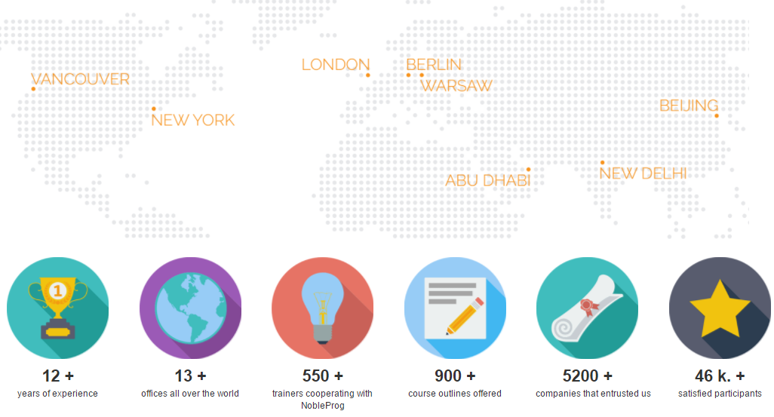
About NobleProg

Slide 3
About Your Trainer
Andreas Maier
Java Developer, Architect and Trainer
Since 2004 professional projects
Freelancer
VW, Allianz, Lufthansa
Trainer
Spring Boot
Container solutions with Docker and Operations with Kubernetes/OpenShift
Event Sourcing with Apache/Confluent Kafka
Microservices Trainings and Workshops

Slide 4
Housekeeping
Schedule
Start 09:00
Finish 16:30
Lunch
30-45 mins
Break
10-15 mins AM
10-15 mins PM
Register (are we all here)
Mobiles silent/off

Slide 5
Course Details
Course Title: Microservice Patterns
During
Course outline: Building Microservices with Spring Cloud and Netflix OSS Training Course
After
Training Evaluation Form
Will be sent to you by one of the training coordinators
Course Attendance Certificate
Will be sent to you by one of the training coordinators

Slide 6
Agenda
Migrating from a Monolithic to a Microservice Architecture
Introduction
Transforming traditional architecture into microservices architecture
Overview of Spring Cloud and Spring Boot Features and Architecture
- Spring Cloud Streams
Overview of Netflix OSS Components
Setting up Your Development Environment
Installing and Configuring Spring Cloud
Creating a Microservices Application
Service Discovery with Netflix Eureka -> consul
Dynamic Routing and Load Balancing with Netflix Ribbon -> consul
Securing Your Microservices with Spring Cloud Api Gateway -> zuul
Ensuring Resiliency with Netflix Hystrix (Implementing the Circuit Breaker Pattern)
Preparing the Database
Reading and Writing to the Database
Using Redis to Buffer Messages
Use AMQP messaging with Spring Boot –> RabbitMQ, ActiveMQ?
Enabling Inter-Service Communication Using Kafka:
Bringing it all Together
Testing the Application
Debugging the Application
Summary and Conclusion

Slide 7
Software Architecture and Microservices
Develoment
Build
Countinous Delivery/Deployment
Big Data
Test
NoSQL
Operations
Spring Boot
Docker
Cloud
Log Aggregation
Monitoring
Management
Organisation and Scrum Feedback Loop
Team
Communication
REST
Registries
Design
DDD
Messaging

Slide 8


Slide 10
Development

Slide 11
Test
Development
Release Management
Versioning
Preparetions
Deployment
Build

Slide 13
A release is not for free.

Slide 14
Monolith

Slide 15
Replacing old technology is complex
Collect more and more functionality
Too big for changes
A lot of functionality
Tests takes hours
One Process
Nobody dares to make any changes
One Delpoyment
Unit

Slide 16
Which monolith did you meet? What qualities did these have?

Slide 17

Rolling out fixes
and functions take a long time
and is expensive.

Slide 18
Elements of Architecture
Data
Interaction
Abstraction
Module
Configuration
Module
Module

Slide 24
article
article
article
article

Slide 25
Service?

Slide 26
UI
Process Service
Business Service
Crud Service
OrderProcess
OrderService
ComplaintsService
CustomerService
ArticleService
AdressService
Database
2004 - 2009

Slide 27
Share Everything

Slide 28
UI
Process Service
Business Service
Crud Service
OrderProcess
OrderService
ComplaintsService
CustomerService
ArticleService
AdressService
Database
2004 - 2009

Slide 29
Google Trends Microservices

Slide 31
Spring Cloud
Definition: common patterns in distributed systems
Features
Distributed/versioned configuration (Arachaius, Spring Cloud Config)
Service registration and discovery (Eureka, Consul)
Routing (Ribbon Client Side, Zuul)
Service-to-service calls
Load balancing
Circuit Breakers (Hystrix)
Global locks
Leadership election and cluster state (Zookeeper -> Kafka)
Distributed messaging (Kafka, RabbitMq, ActiveMq)

Slide 32
Netflix OSS Components
Tools
Eureka
Hystrix
Rest Client with Feign
Ribbon
Archaius
Zuul
Netflix.github.io
Common Runtime Services & Libraries

Slide 33
IDEs and Tools
Eclipse STS Spring Tool Suite based on Eclipse
IntelliJ IDEA Ulitmate
VS-Code
Remote Development
Fast and resource saving

Slide 34
A microservice is ....

Slide 35
Small

Slide 36
independently

Slide 37
Has only one responsibility

Slide 38
McIlroy founder of pipe | in unix
This is the Unix philosophy: Write programs that do one thing and do it well. Write programs to work together. Write programs to handle text streams, because that is a universal interface.
Only one responsibility

Slide 39
communicate,

Slide 40
Is behaving well

Slide 41
Is organized around a Business Capability

Slide 42
The development, installation, operation and monitor can be done isolated.

Slide 43
Advantages of Microservices
Flexibility
Changes are fast in production
Stability in operation
Isolation of errors
Scalability
Use of the most appropriate technology for a task
Better distribution of tasks
Isolation of errors and problems
Continuous improvement
Feedback loop
Reduces complexity
Migration to new technologies is easier and more incrementally possible
Better prepared for change

Slide 44
Amazon

Slide 46
To handle nonfunctional requirement will be very important!

Slide 48
Isolation
Code
Data
Datastructure
UI
Running Environment
Team

Slide 51
Event Bus

Slide 52
Event Bus
A key challenge with Service Oriented Architecture (SOA) is that messages were routed through a centralized Enterprise Service Bus (ESB), which was too “intelligent.” The microservice community favours an alternative approach: smart endpoints and dumb pipes. —Martin Fowler, 2014

Slide 53
Event Bus

Slide 54
Event Bus

Slide 55
Listner Logic

Slide 56
Eventual Consistency

Slide 57
Microservices Transactions

Slide 58
Microservices Transactions
Transactions exists within a service
Avoid transactions, the real world is without them
Sagas Compensation

Slide 59
Patterns
Competing Workers Pattern
Fanout Pattern
Facade Design Pattern
Proxy Design Pattern
Stateless Service Pattern
Circuit Breaker Pattern
Microservices Composition
Broker Composition Pattern
Aggregate Composition Pattern
Chained Composition Pattern
Proxy Composition Pattern
Batch Composition Pattern
Transaction Patterns
Two Phase Commit
Saga Pattern
Eventual Consistency

Slide 60
Competing Workers Pattern - Scalability

Slide 61
Fanout Pattern – One Event triggers many tasks

Slide 62
Façade Design Pattern

Slide 63
Proxy Design Pattern
Security
Validation
Simplification
Holder for another object
Proxy Object dosen´t contain business logic

Slide 64
Stateless Service Pattern
Avoid state in Services
No state information maintained
Clients maintain state
State is part of the request
Scalability, Performance, Availability
Increased network traffic

Slide 65
Broker Composition Patterns

Slide 66
Aggregate Composition Pattern

Slide 67
Chained Composition Pattern

Slide 68
Proxy Composition Pattern

Slide 69
Branch Composition Pattern

Slide 70
Saga Pattern
Transactions are many requests
Track the requests
Failure Management
Compensate requests
Saga log

Slide 71
ERD Diagramm

Slide 72
Cohesion
Cohesion (from Latin cohaesiō "cling" or "unity") or cohesive attraction or cohesive force is the action or property of like molecules sticking together, being mutually attractive.
https://en.wikipedia.org/wiki/Cohesion_(chemistry)
In computer programming, cohesion refers to the degree to which the elements inside a module belong together.^{[1]} In one sense, it is a measure of the strength of relationship between the methods and data of a class and some unifying purpose or concept served by that class. In another sense, it is a measure of the strength of relationship between the class's methods and data themselves. https://en.wikipedia.org/wiki/Cohesion_(computer_science)

Slide 73
Coupling

Slide 74
High cohesion & decoupled

Slide 75

ERD Diagramm

Slide 76

ERD Diagramm

Slide 77
ERD Diagramm
Redundancy?

Slide 78
ERD Diagramm

Slide 79
ERD Diagramm
?

Slide 80
ERD Diagramm

Slide 81

ERD Diagramm
"Dieses Foto" von Unbekannter Autor ist lizenziert gemäß CC BY-SA

Slide 82
"Dieses Foto" von Unbekannter Autor ist lizenziert gemäß CC BY-SA

Slide 83

ERD Diagramm
"Dieses Foto" von Unbekannter Autor ist lizenziert gemäß CC BY-SA

Slide 84

Any questions?
Questions & Answers

Slide 85

Thank you!
Contact
NobleProg
Andreas Maier
www.nobleprog.co.uk

